Slide 1


Community Service Project: Animals and Species
The "Grami Pashu Sahayak" Web-Based Awareness Platform
Team Members
Guide
Dharmendra Prasaila Yadav (23781A33J3)
Dr. Mohan raj, Ph.D.
Rajan Prasaila Yadav (23781A33J5)
Nitesh Mehta (23781A33J4)
Chode S Arjun Kumar (23781A33J2)
Institution
Department of Computer Science and Engineering (AI-ML), Sri Venkateswara College of Engineering & Technology (Autonomous), Chittoor

Slide 2
The Challenge in Nandanoor Village
Nandanoor village, located in Chittoor District, is a rural community heavily reliant on agriculture and livestock farming, primarily involving cows, buffaloes, and goats. Despite the crucial role these animals play in the villagers' livelihoods, significant challenges hinder optimal animal care and productivity.
Lack of Veterinary Support
Low Awareness
Poor Hygiene
Farmers often struggle to access timely and effective medical assistance for their animals due to limited veterinary services in the area.
There is a widespread lack of knowledge regarding balanced diets, proper feeding schedules, and modern nutritional practices for livestock.
Animal sheds are frequently not cleaned regularly, leading to unsanitary conditions that foster infections and disease.
Irregular Vaccination
Information Gap
Most farmers do not adhere to a consistent vaccination schedule for their animals, largely due to a lack of guidance and awareness of its importance.
Villagers have restricted access to reliable, up-to-date information and resources concerning comprehensive animal care.

Slide 3
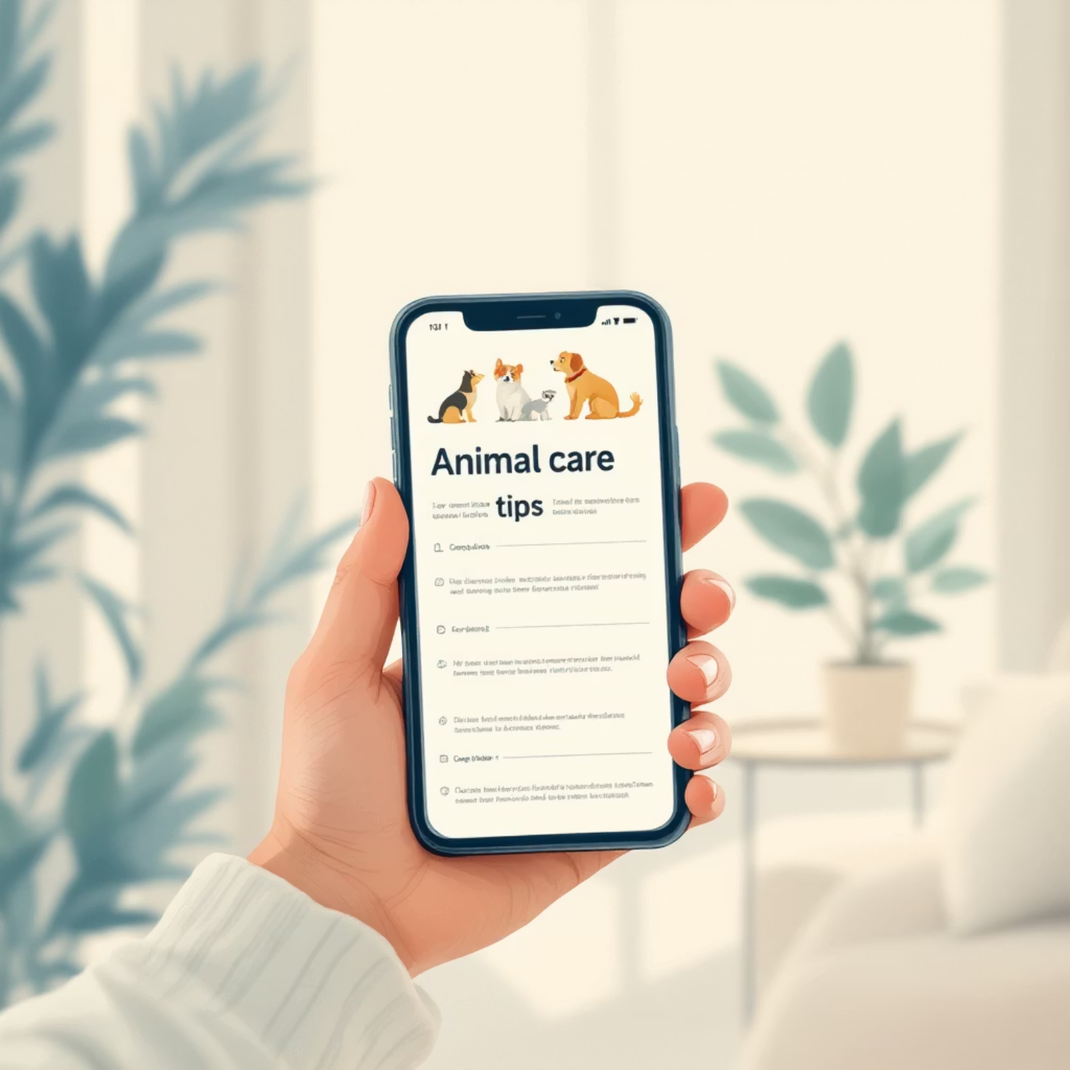
Objective & Our Solution: "Grami Pashu Sahayak"
Recognizing the urgent need for accessible animal care resources in rural communities, our project aimed to bridge the information gap through a tailored digital solution.
Main Objective
Our Solution: "Grami Pashu Sahayak" Web App
To design and implement a simple, web-based platform providing essential animal care tips, feeding guides, and awareness materials to help Nandanoor villagers manage their animals in a healthier, more informed way.
Our response to these challenges is the "Grami Pashu Sahayak" (Village Animal Helper) web application, designed to be a user-friendly and practical tool for local farmers.
Key Features
Provides simple and actionable tips on feeding, hygiene, and vaccination protocols.
Designed using easy-to-understand language and visual aids, ensuring accessibility for all users regardless of literacy levels.
Features informative posters and short, practical guides on various aspects of animal health.
Built with accessible web technologies (HTML, CSS, JavaScript) to ensure functionality on basic smartphones and limited internet connectivity.

Slide 4
Our Process
Our project followed a systematic methodology, ensuring deep community engagement and a solution tailored to the specific needs of Nandanoor village.
01
02
Community Interaction
Problem Identification
We initiated our project by visiting Nandanoor village, conducting direct interactions with farmers to gather first-hand information on existing feeding practices, hygiene standards, and prevalent animal health issues.
Through our field observations and discussions, we pinpointed common challenges such as the critical lack of timely veterinary support and a general low awareness regarding modern animal husbandry.
03
04
Solution Brainstorming
Development
Collaborating with the farmers, we brainstormed potential solutions, which led to the concept of a simple, accessible web platform specifically for animal-care awareness.
Based on the insights gathered, our team developed a functional prototype of the web application, christened "Grami Pashu Sahayak," incorporating essential features and content.
05
06
Testing & Demonstration
Feedback Incorporation
The prototype was then presented to the villagers. We provided comprehensive demonstrations of its use, explaining its benefits, and meticulously recorded their initial feedback and suggestions.
The valuable feedback received from the farmers was instrumental. We subsequently refined and improved the content and design of the web application to better meet their needs and enhance user experience.

Slide 5




Web App Prototype Showcase
The "Grami Pashu Sahayak" web application is designed with an intuitive interface to ensure ease of use for the farming community.
1
2
Main Dashboard
Daily Care Routine
Features clear sections for Veterinary Care and Expert Tips, providing quick access to critical information.
Offers structured guidance on routine animal management, promoting consistent and healthy practices.
3
4
Local Vets List
Our Team / Contact Us
Connects farmers with available local veterinary services, facilitating timely medical assistance.
Provides avenues for users to connect with the development team for support or inquiries.

Slide 6

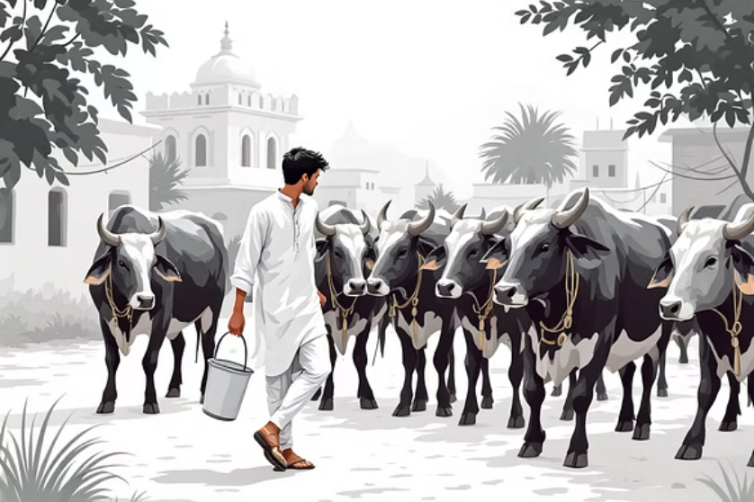
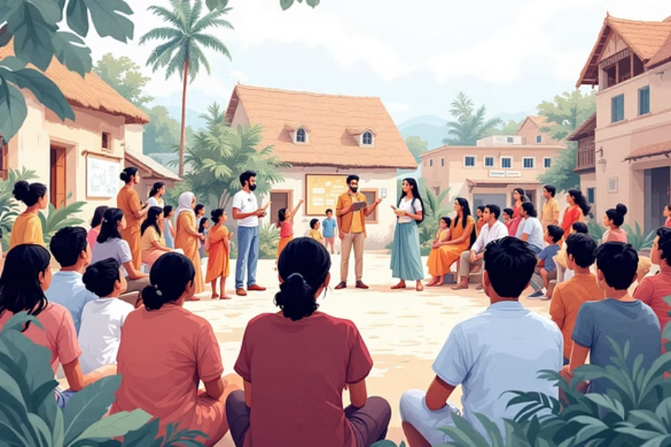

On-Site Field Work & Engagement
"Engaging directly with the Nandanoor community was paramount to understanding their unique needs, gathering invaluable feedback, and effectively demonstrating the practical benefits of our digital solution."
Our team immersed themselves in the daily lives of Nandanoor villagers, conducting hands-on sessions and interactive demonstrations. This direct engagement allowed us to build rapport, understand the nuances of their traditional animal care practices, and tailor our awareness program to resonate effectively within the community. These experiences were crucial for the successful adoption and refinement of the "Grami Pashu Sahayak" platform.

Slide 7
Outcomes & Community Impact
The implementation of the "Grami Pashu Sahayak" project has yielded tangible benefits and fostered a positive transformation within the Nandanoor village community.
Enhanced Knowledge
Farmers gained significant insights into proper animal care, including improved feeding strategies, effective hygiene practices, and essential health management.
Positive Reception
The "Grami Pashu Sahayak" web app was met with enthusiastic interest from the community, indicating a strong desire for accessible information.
Practical Adoption
Several farmers expressed their readiness to integrate the app into their routines for vaccination reminders and daily animal care tips, highlighting its practical utility.
Strengthened Relations
Our awareness sessions fostered a strong bond of trust and mutual understanding between our project team and the local farming community.
Empowerment
The project successfully blended traditional animal care wisdom with simple digital learning tools, empowering farmers with renewed confidence and capabilities.

Slide 8

Our Key Learnings
This community service project was not only about delivering a solution but also a profound learning experience for our team, fostering valuable skills and perspectives.
Values Acquired
Life Skills Developed
Technical Skills Acquired
Empathy
Problem-Solving
Web Development
Gained a deeper understanding of the real-world challenges faced by rural animal keepers.
Honed abilities to identify practical issues and devise simple, effective solutions.
Gained practical experience in creating web pages using fundamental technologies like HTML, CSS, and JavaScript.
Responsibility
Communication
Recognized the societal importance of applying technical skills for community welfare.
Improved clarity in interactions with farmers, academic guides, and fellow team members.
UI Design
Learned principles of designing user-friendly interfaces to effectively display animal-care information.
Teamwork
Developed essential collaboration skills through working with team members and villagers.

Slide 9
Conclusion & Future Recommendations
The "Grami Pashu Sahayak" project represents a successful endeavor in leveraging simple digital solutions for meaningful community development.
Conclusion
Future Recommendations
We successfully developed and deployed "Grami Pashu Sahayak," an intuitive web application aimed at empowering farmers with critical animal care knowledge. The overwhelmingly positive feedback from the community underscores the significant impact that accessible digital tools can have in fostering health and well-being in rural settings.
To maximize the reach and impact of this initiative, we propose several key future directions:
Expand the app's deployment to additional nearby villages facing similar challenges.
Conduct regular training workshops to educate farmers on effectively utilizing the app's features.
Forge partnerships with local veterinary hospitals and non-governmental organizations to enhance support services.
Ensure the app's content is available in local languages and optimized for low-internet connectivity to maximize accessibility.

Slide 10
Acknowledgements
This project would not have been possible without the invaluable guidance, support, and dedication of several individuals and organizations.
We extend our deepest gratitude to our esteemed guide, Dr. Mohanraj Ramamoorthy, for his unwavering inspiration, expert mentorship, and continuous support throughout the project lifecycle.
Our sincere thanks go to our Head of Department, Dr. M Lavanya, and our respected Principal, Dr. M. MOHAN BABU, for providing the necessary resources and fostering an environment conducive to this community service initiative.
We are especially thankful to the farmers and community members of Nandanoor village for their generous allocation of time, their openness in sharing their experiences, and their invaluable feedback, which was crucial to the project's success.
Finally, we express our heartfelt appreciation to our parents and friends for their constant encouragement and belief in our endeavors.
Thank You. Questions?

